Slide 1
Unit – V
Accounts of Insurance Companies and Insurance Claims

Slide 2
Introduction
Insurance is an agreement to make the loss or damage suffered by a person good by another person for consideration called Premium.
The person whose risk is covered is called Insured.
The company or the party which insures is called an Insurer.
The documents that give the terms and conditions of the insurance is an Insurance Policy.

Slide 3
Classification of Insurance
Insurance is classified into two types. They are
Life Insurance :As the name suggests, life insurance contract covers the risk associated with the life of human beings. These policies are generally long term policies.
General Insurance : On the other hand, all the insurances other than life are covered under general insurance. These contracts are usually made for one year. Examples: Marine insurance, Fire Insurance, Accidental, crop, Burglary Insurance etc.

Slide 4
Accounting records for Life insurance
According to the life insurance corporation 1956, the following records are prepared and maintained by the life insurance companies.
Revenue Account (form A - RA)
Profit & Loss Account (Form A - PL)
Balance Sheet (Form A - BS)

Slide 5
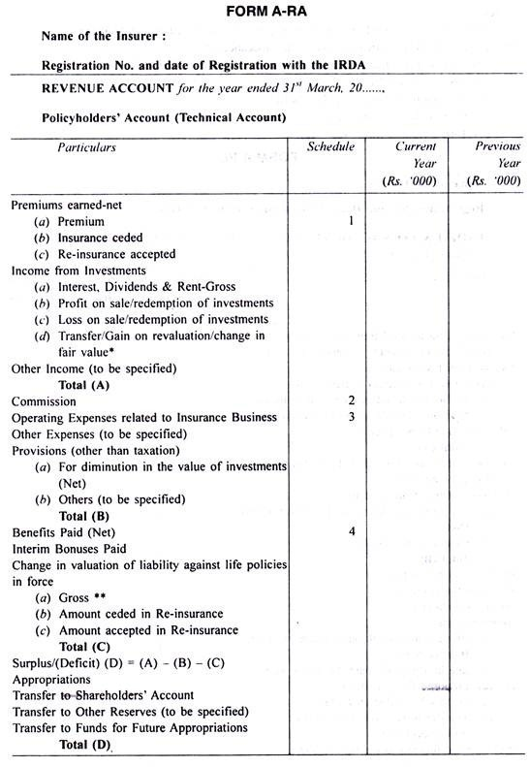

Slide 6
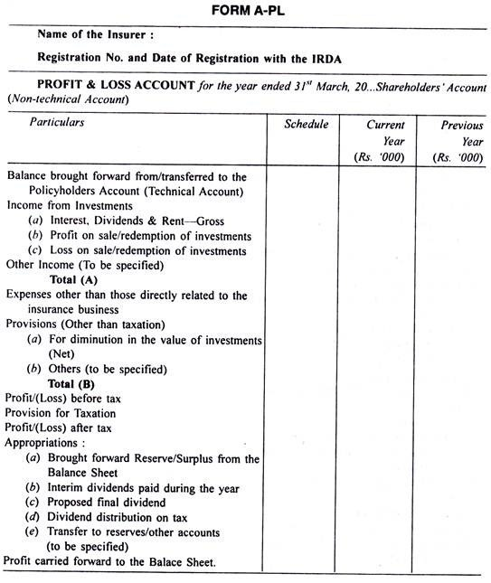

Slide 7
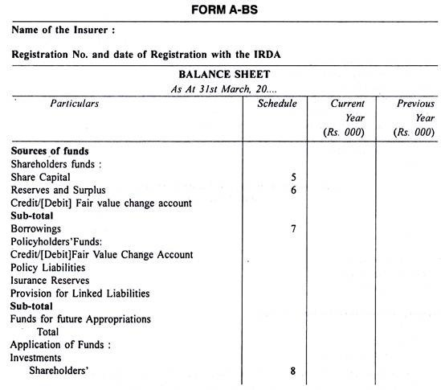
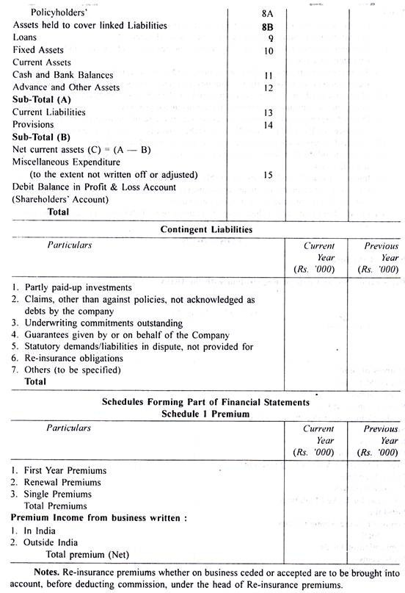

Slide 8
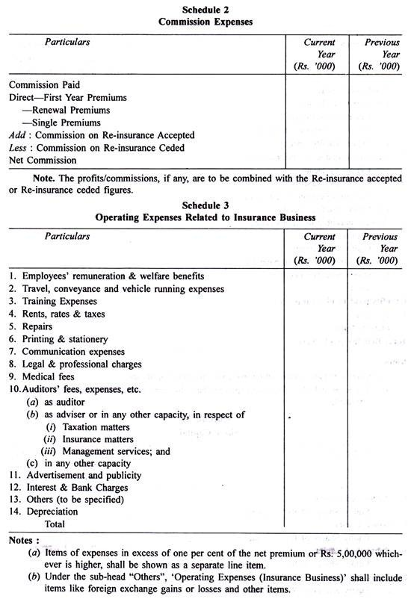
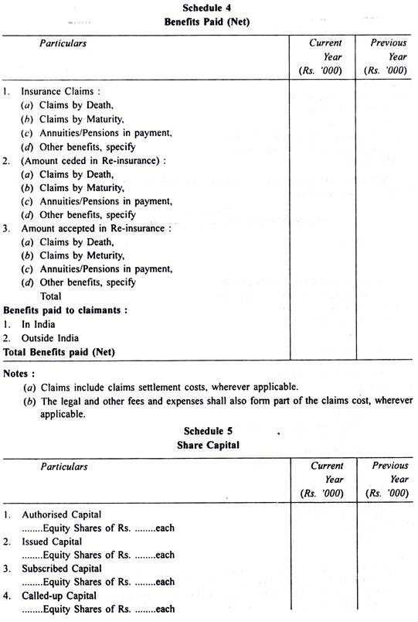

Slide 9
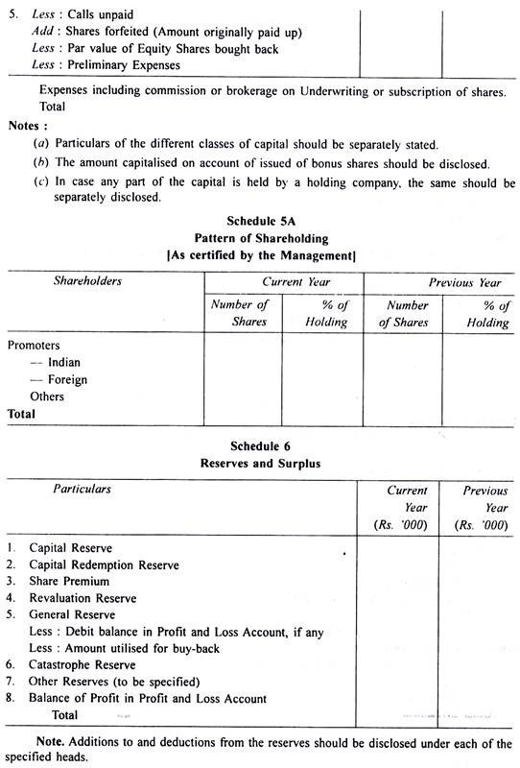
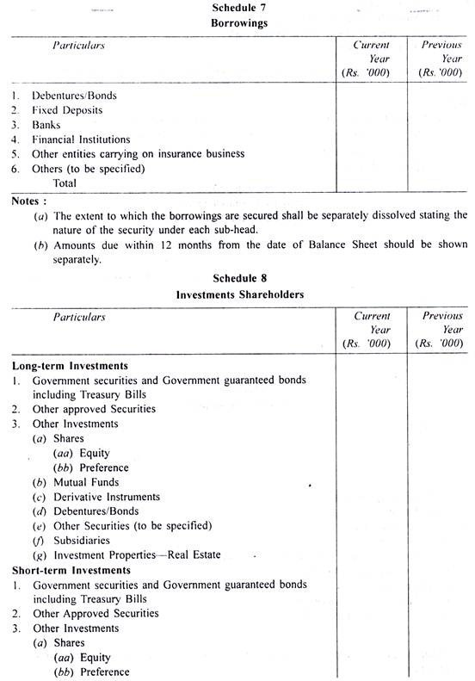

Slide 10
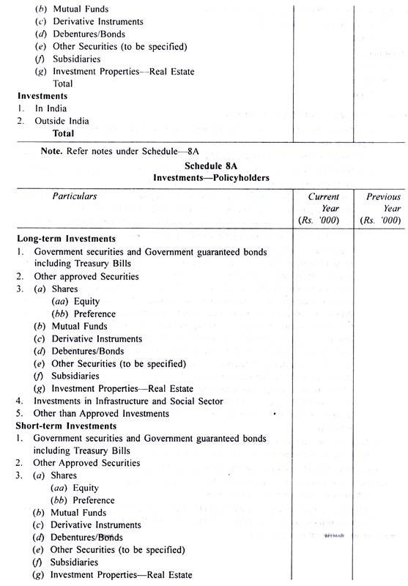
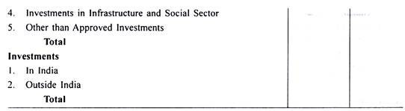
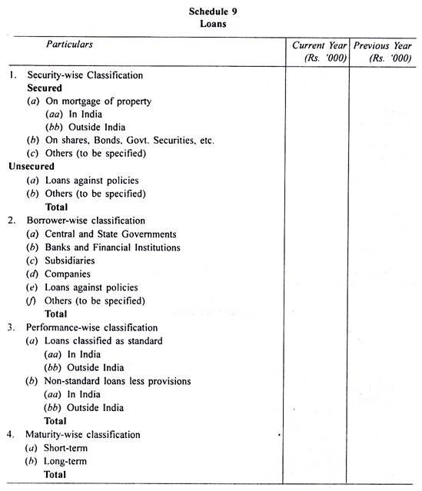

Slide 11
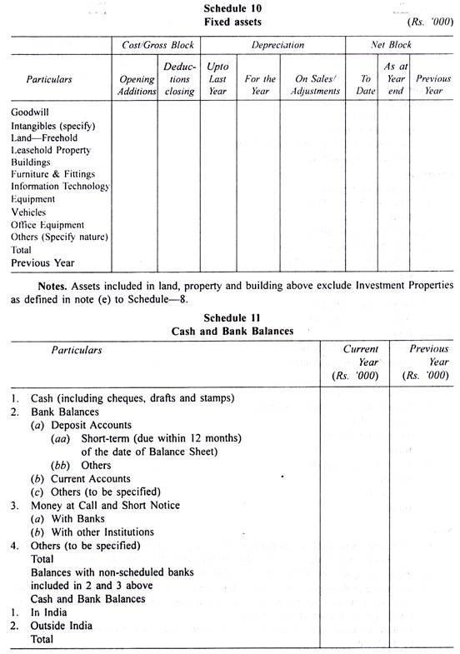
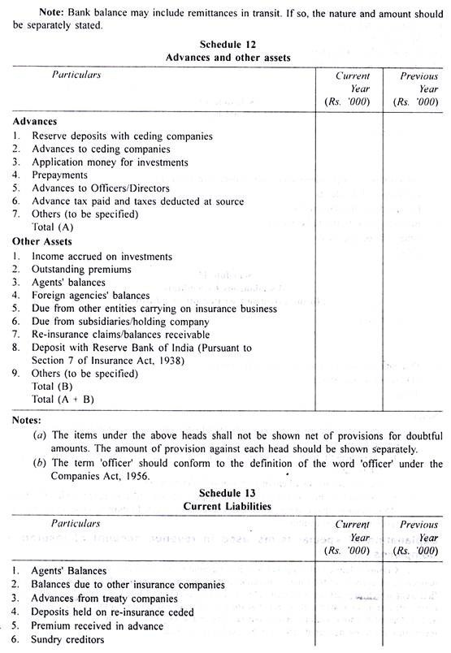

Slide 12
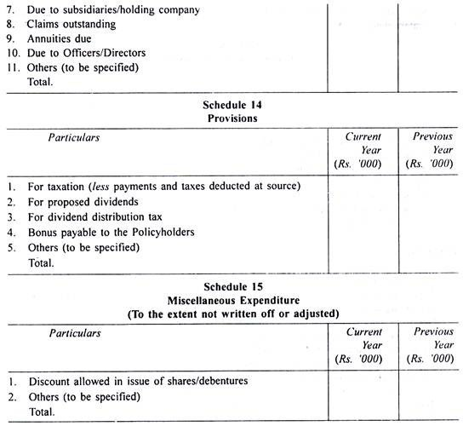

Slide 13
Terms to understand
First year Premium: The premium received incase of Life insurance for the first time.
Renewal premium: the premium received for the subsequent years.
Single Premium: Premium that is paid only once, at the time of taking the policy.
Claims: It is any amount to be paid by the insurance company to the policyholders, on the death or maturity.
Annuity: It is the annual payment that is paid by the insurance company for the lumpsum amount received in the form of consideration.
Surrender: The sale of the policy by the insured to the insurance company before its maturity.

Slide 14
Cont..
Reinsurance: When an insurance company insures its risk with another insurance company mainly to reduce the risk is called reinsurance.
Premium on reinsurance ceded: The premium payable by the original insurer to the reinsurer is called Premium on Reinsurance ceded.
Premium on Reinsurance accepted: The premium receivable by the reinsurer from the original insurer is called Premium on Reinsurance accepted.
Claims on reinsurance ceded: It is the claim amount recieved or recievable from the reinsurer for reinsurance ceded.

Slide 15
Cont..
Claims on Reinsurance accepted: It is the amount paid or to be paid to the other insurers for the reinsurance accepted.
Commission on Reinsurance ceded: It is the commission that is recieved by the original insurer for transfering the business to the reinsurer.
Commission on Reinsurance accepted: It is the commission that is paid to the original insurer on accepting such bussiness thats transfered to them.

Slide 16
Accounting Records for General Insurance
According to IRDA regulations 2002 the following accounts are to be prepared for the general insurance contracts.
Revenue Account (Form B – RA)
Profit and Loss Account (Form B – PL)
Balance Sheet (Form B – BS)

Slide 17
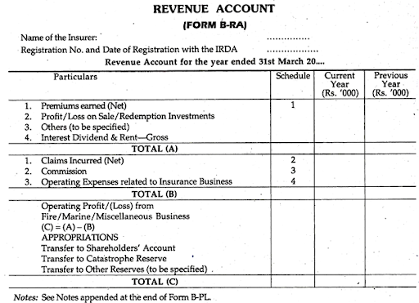

Slide 18
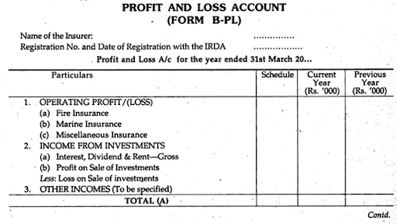
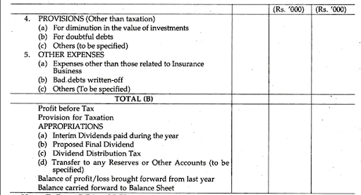

Slide 19
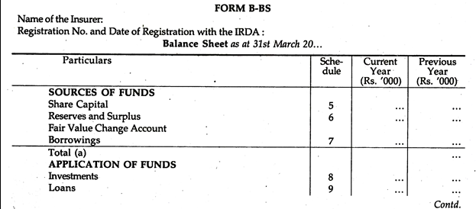
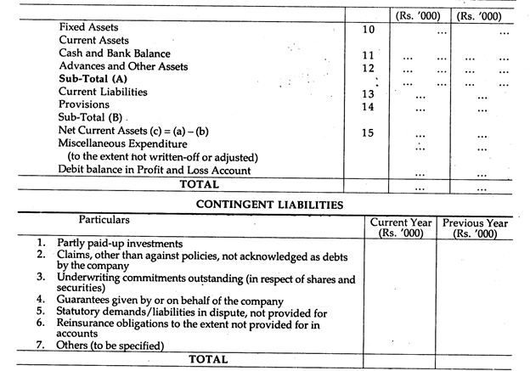

Slide 20
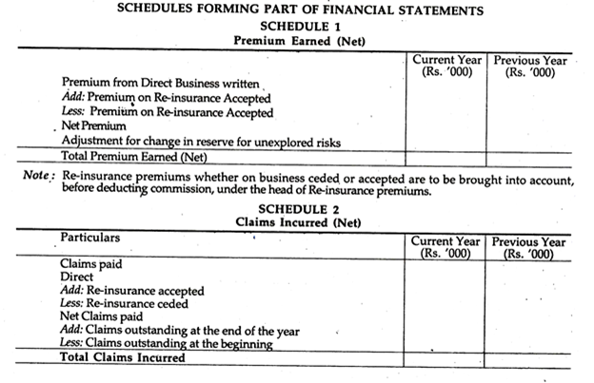
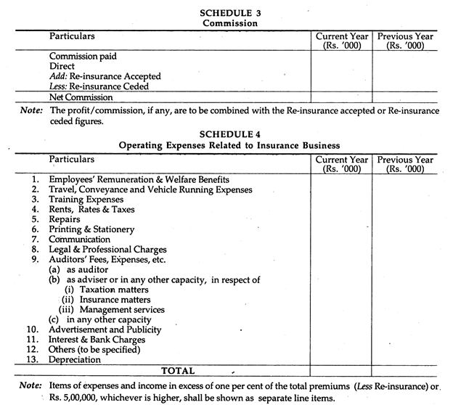

Slide 21
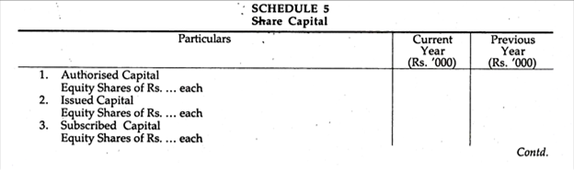
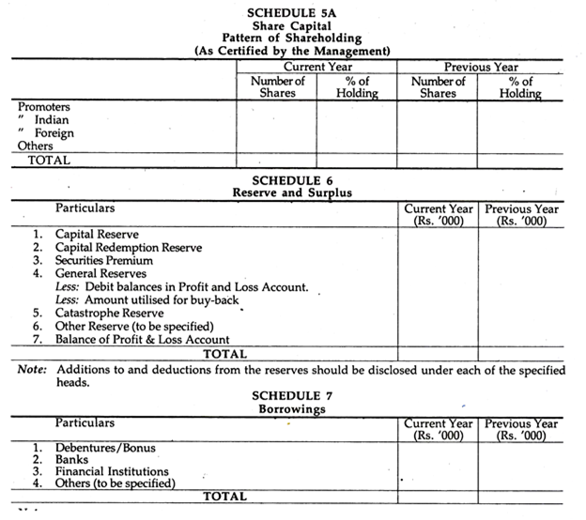
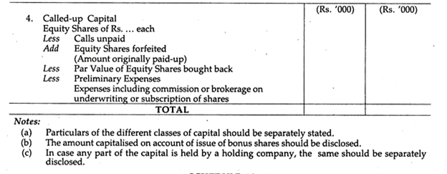

Slide 22
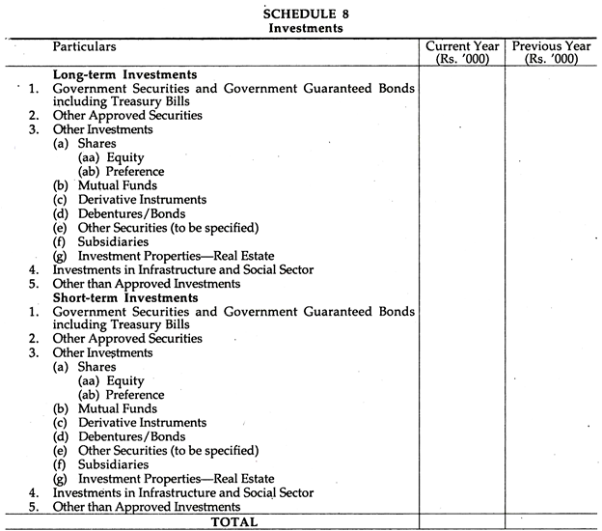
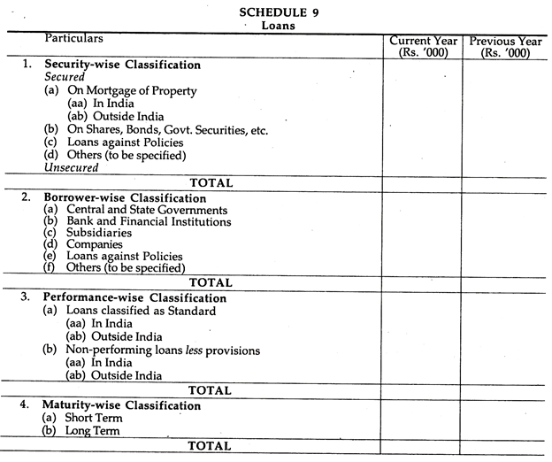

Slide 23
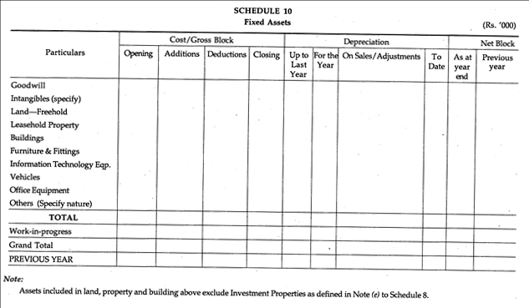
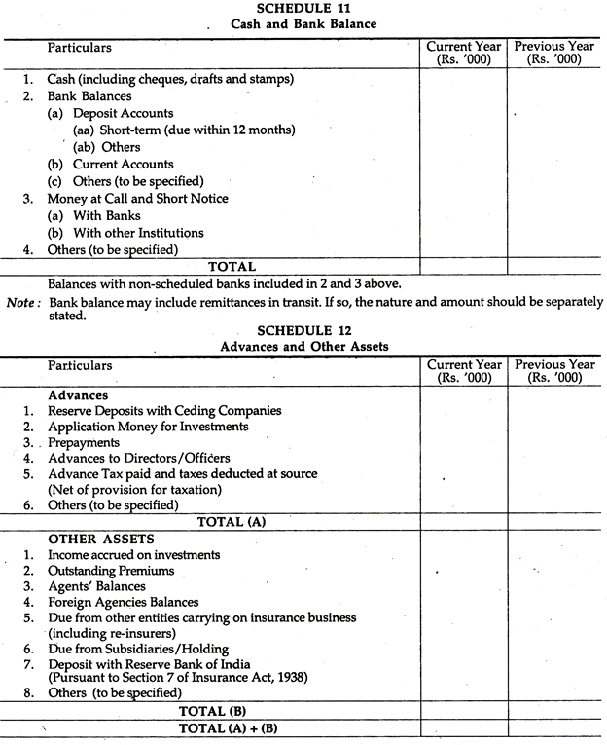

Slide 24
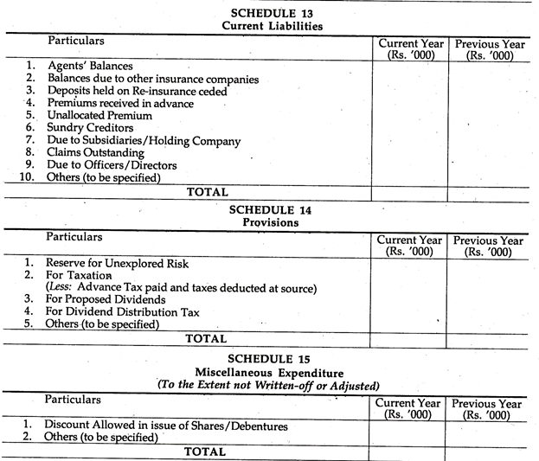

Slide 25
Insurance claims
Incase of a fire accident, all the assets like Land & Buildings, Plant & Machinery, Furniture, stock etc., shall be destroyed.
Incase of stock, it becomes necessary to calculate the value of stock in hand at the time of fire unlike other assets which have records maintained in the books of accounts
Value of the stock destroyed by fire is calculated by preparing a Memorandum Trading Account till the date of fire.
The amount of claim from the insurance company is calculated by deducting the salvaged stock from the closing stock.

Slide 26
Memorandum Trading Account
Particulars | Amount(Rs.) | Particulars | Amount (Rs.)
To opening stock | XXX | By sales less returns | XXX
To Purchases less returns | XXX | By closing stock (balancing figure) | XXX
To Wages (+) outstanding | XXX
To other Manufacturing expenses | XXX
To Gross Profit c/d | XXX
 | XXXX |  | XXXX

